Slide 1
Algebra Revision
Miss L
Year 8

Slide 2
What will be on the Mini-Test
Algebra definitions
Like terms
Adding and subtracting
Multiply and divide
Expand and Factorise expressions
Substitution

Slide 3
Algebra Definitions – Words we have covered
Variable
Expression
Coefficient
Constant
Term
Substitution
Expand
Factorise

Slide 4
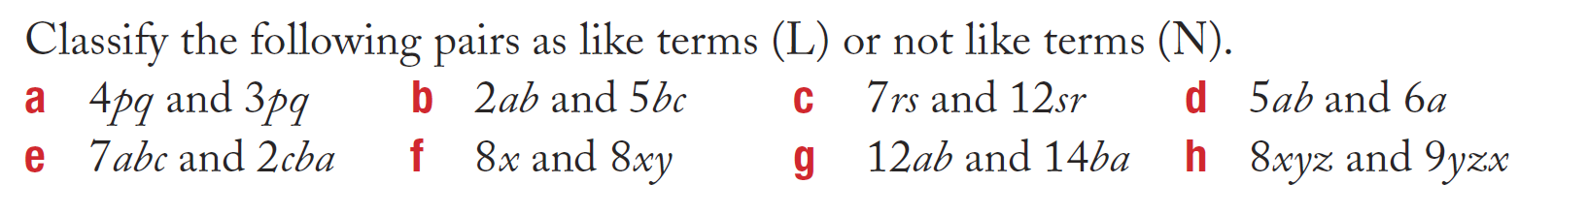
Working with Like Terms

Slide 5
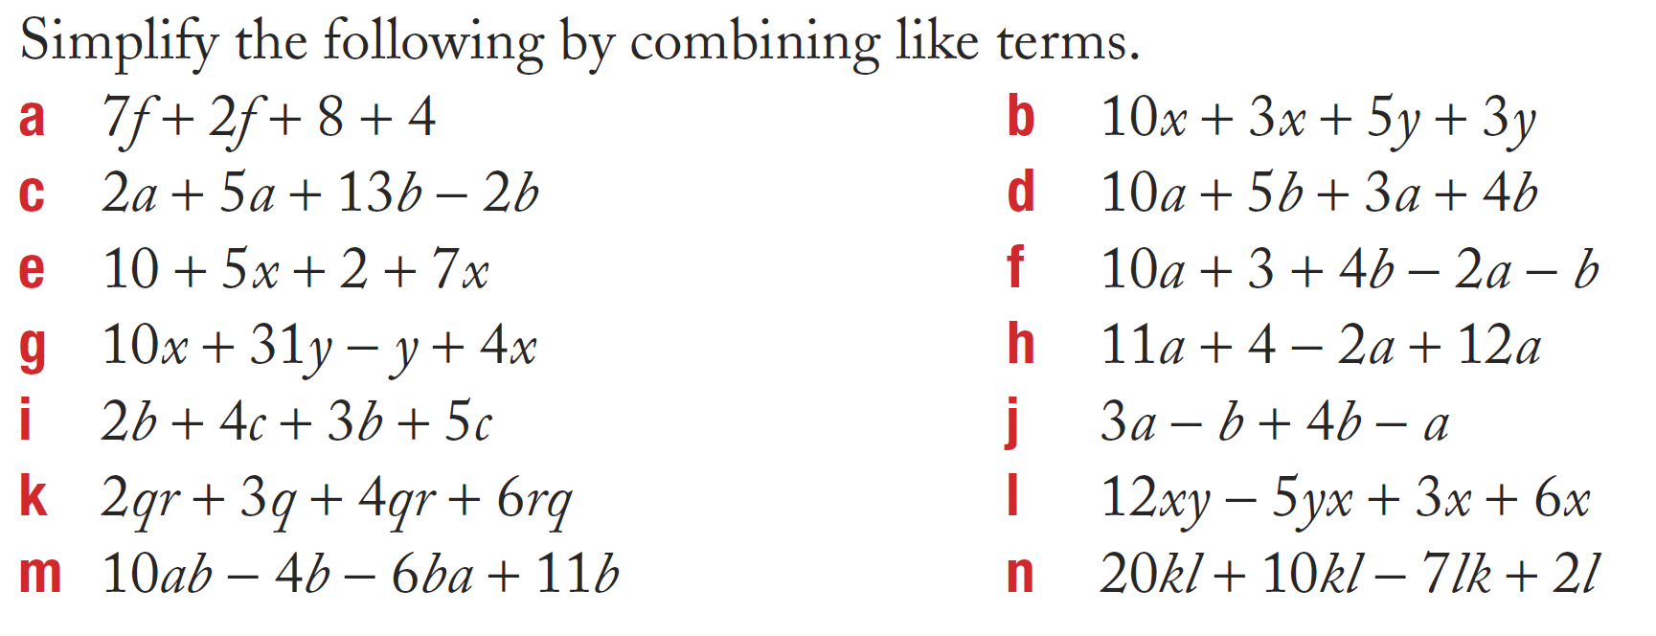
Working with Like Terms

Slide 6
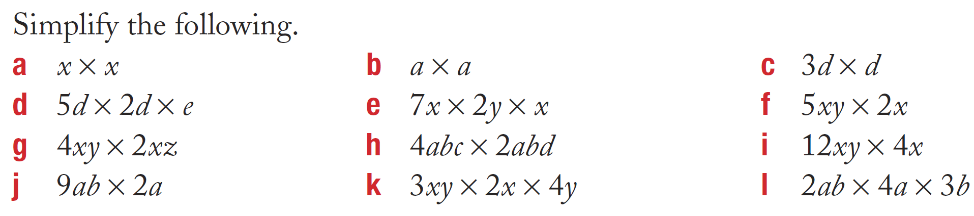
Working with Like Terms

Slide 7
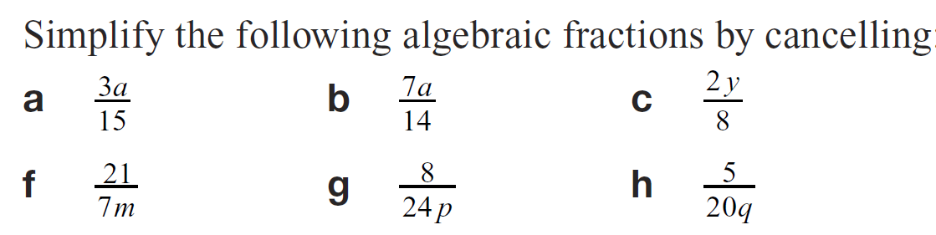
Working with Like Terms

Slide 8
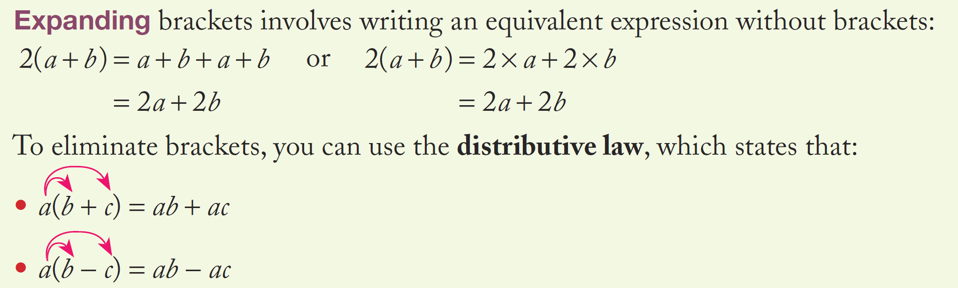
Expanding Brackets

Slide 9
Expanding Brackets

Slide 10
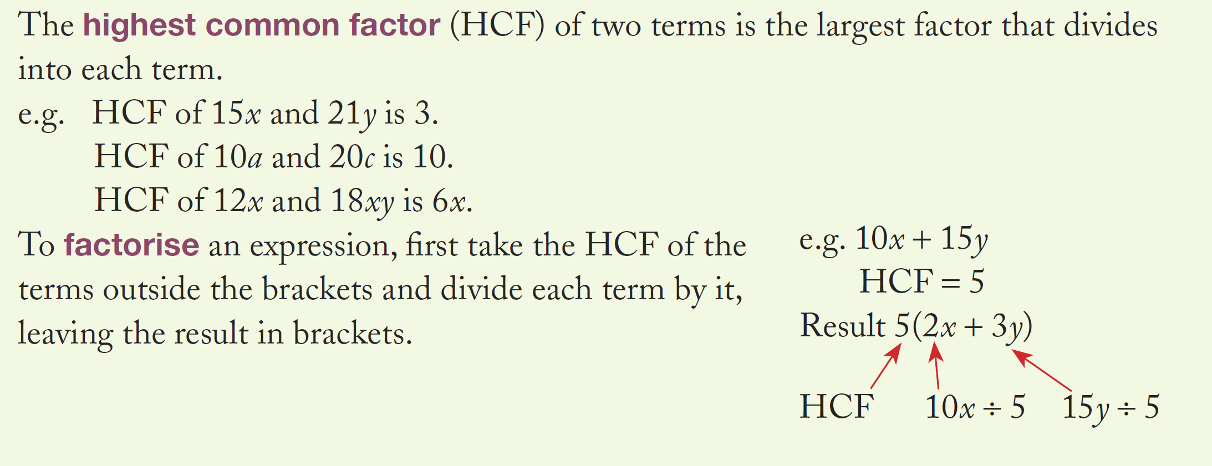
Factorising Expressions

Slide 11
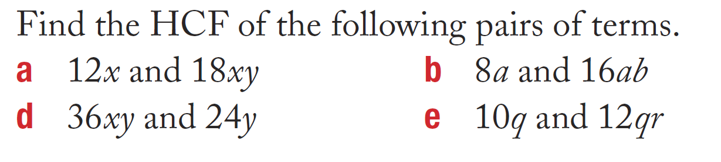
Factorising Expressions

Slide 12
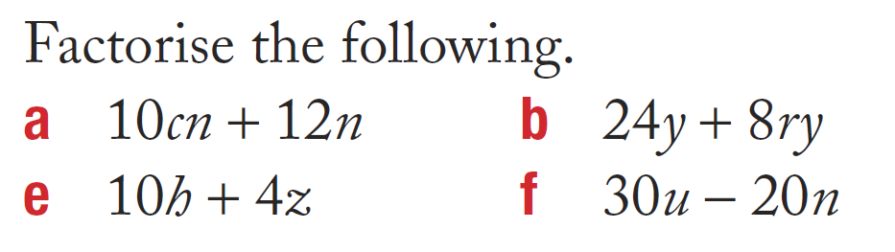
Factorising Expressions

Slide 13
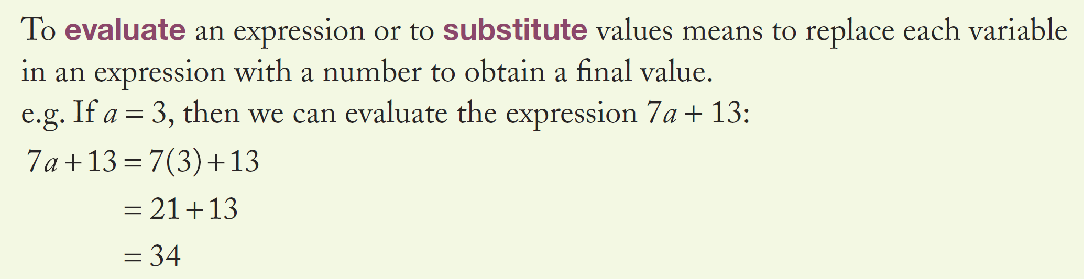
Substitution

Slide 14
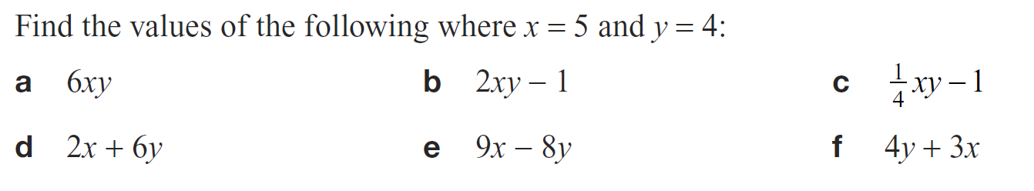
Substitution

